Slide 1

SEAlert
Child Care System
December 13, 2017
Sreerag Mandakathil Sreenath
1838559
Aahana Khajanchi
1824402
Eklavya Saxena
1850025

Slide 2
Background
In India, two-thirds of children do not receive their vaccinations on time, prolonging their susceptibility to diseases and contributing to untimely deaths [source]
This is mainly caused due to the lack of information on the importance of vaccination by the newly formed parents
Despite India being the leading producer and exporter of vaccines, the country has the greatest number of deaths among children under the age of 5 – the majority are from vaccine preventable diseases
As stated by Government of India, from February 2018, it will be mandatory for every mobile phone numbers active in the market to be linked with citizens’ AADHAAR Card (issued by Unique Identification Authority of India)
Number of Indian mobile users rises by 13.75 million to 1.16 billion in February 2017: TRAI [source]
The number of mobile user without internet is also growing steadily in rural and backward regions of India

Slide 3
Problem Statement
To create a child care support and education system to
Alert parents of the upcoming vaccination doses for their children
To bring synergy among parents, vaccine service provider and distributor
Maintain valid inventory of the stocked item

Slide 4
Target audience
Manufacturers
Vaccine Distributors
Hospitals
Government Regulators
Parents and children

Slide 5
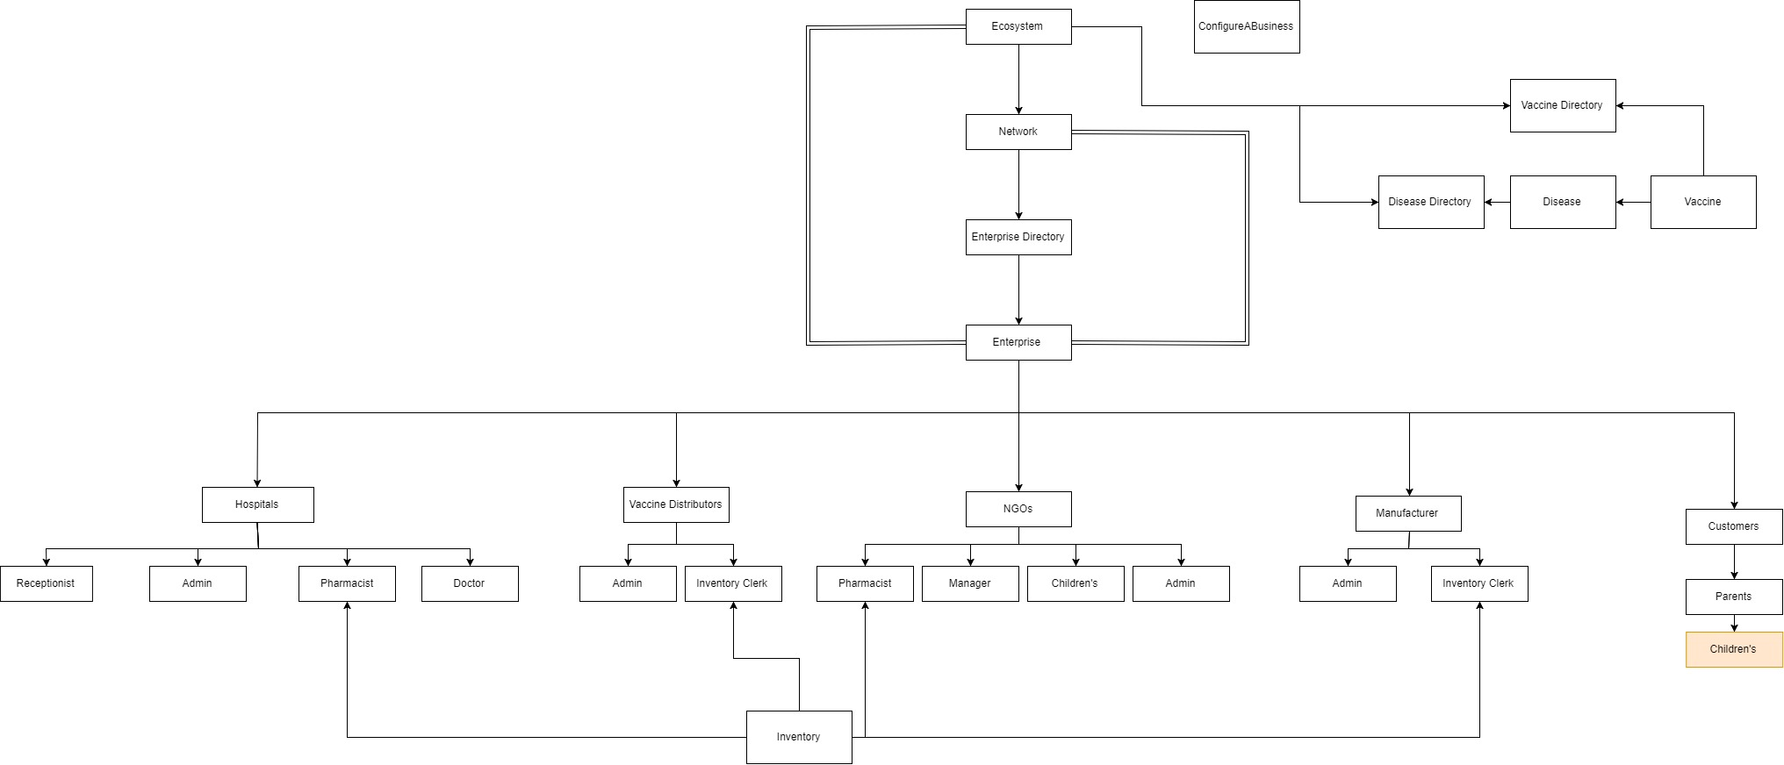
Object Model

Slide 6
Actors and Use Cases
Hospital
Distributor
Manufacturer
Doctors administers the doses to children
Stores manage inventory
Receptionist Manages child data entry
Supplies Vaccine to hospitals and other Distributors in and out of network
Request Vaccine from Different manufacturers
Is local to a network(State)
Can produce only regulated and approved vaccine from government
Supplies to Distributors

Slide 7
Features
A doctor can only administer a valid and non-expired batch of vaccine
Vaccine distributor and Manufacturer can only distribute non-expired vaccine
Alert system for parents to know about the next vaccine dose and repercussions of not taking them, also in which hospital vaccine is available
Parents can check the vaccination history for their child
Real time database using jdbc
Distributors will know how many children are coming for each vaccine for the following month
Validation of input data

Slide 8
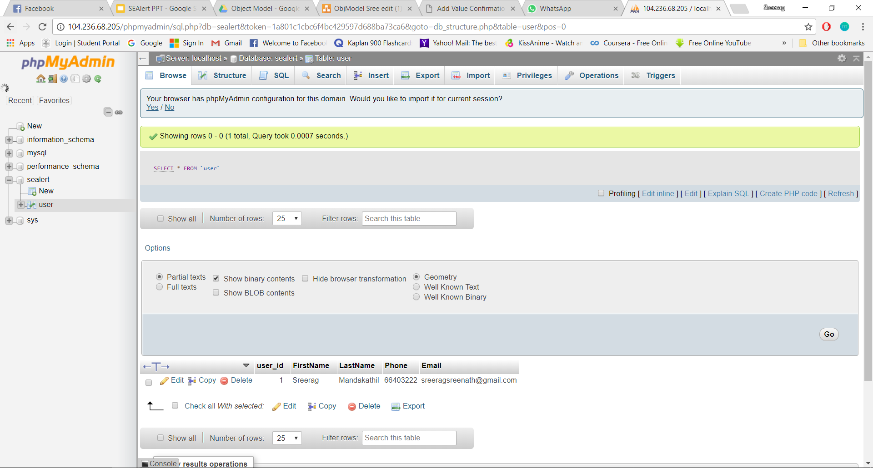
Server Screenshot

Slide 9
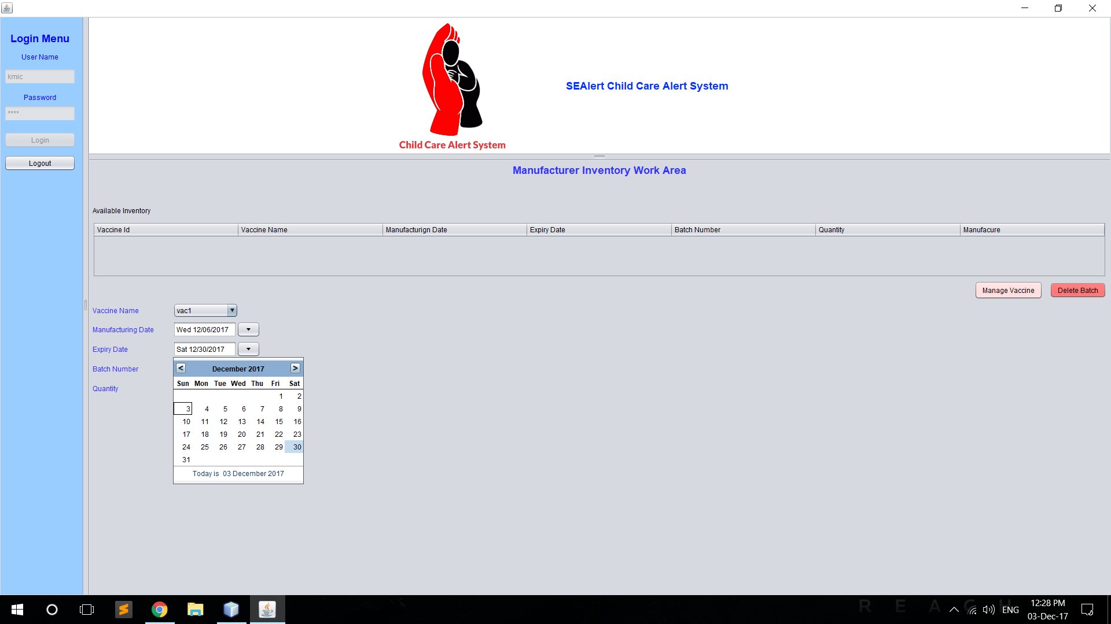
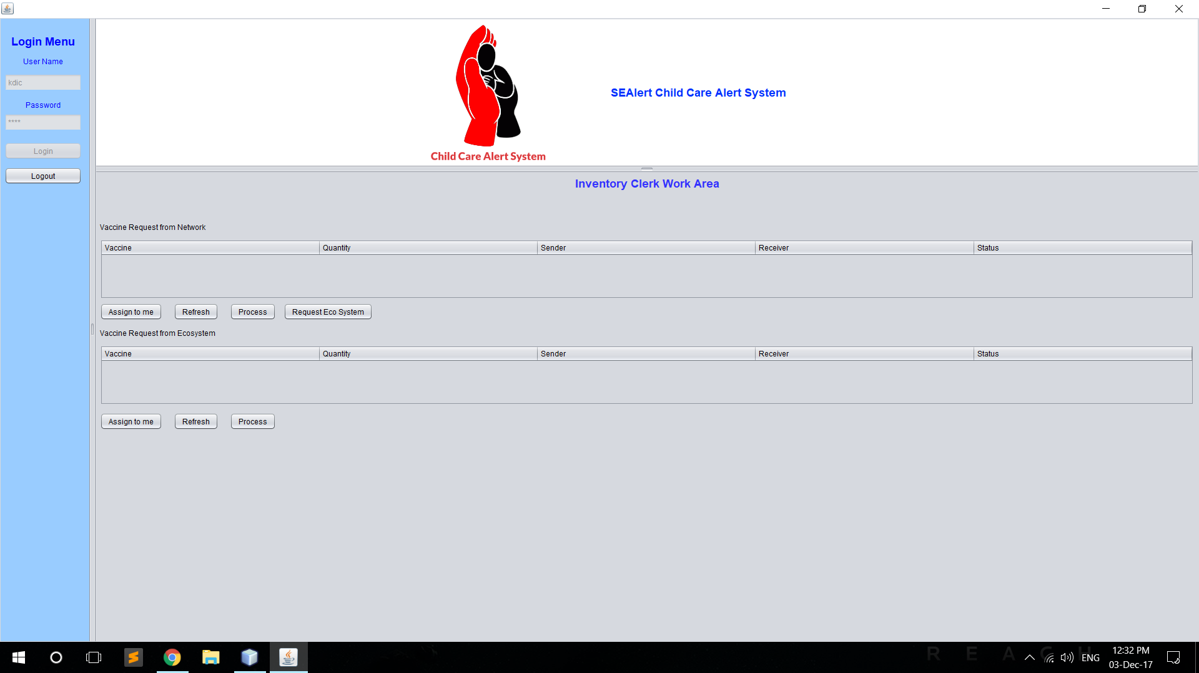
Easy to Use UI

Slide 10
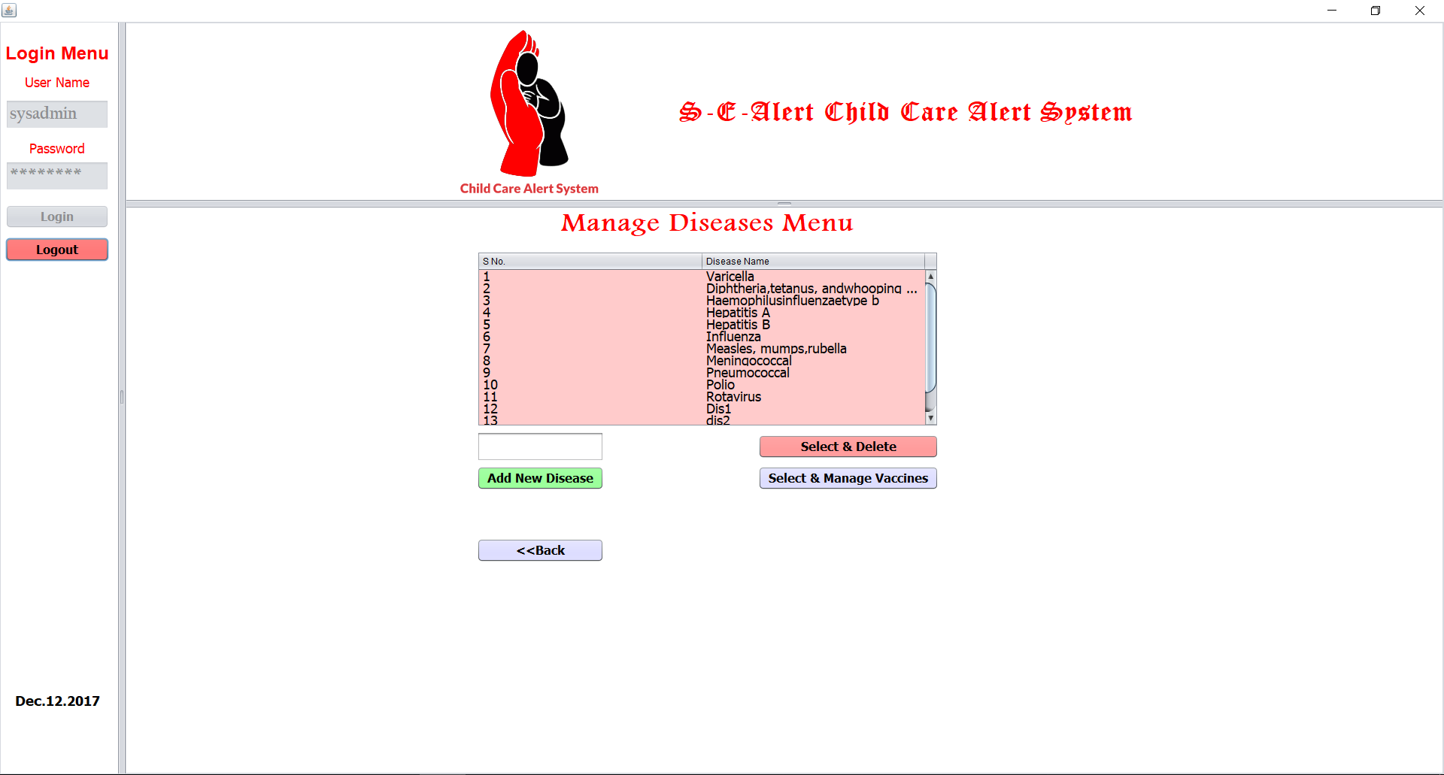

Slide 11
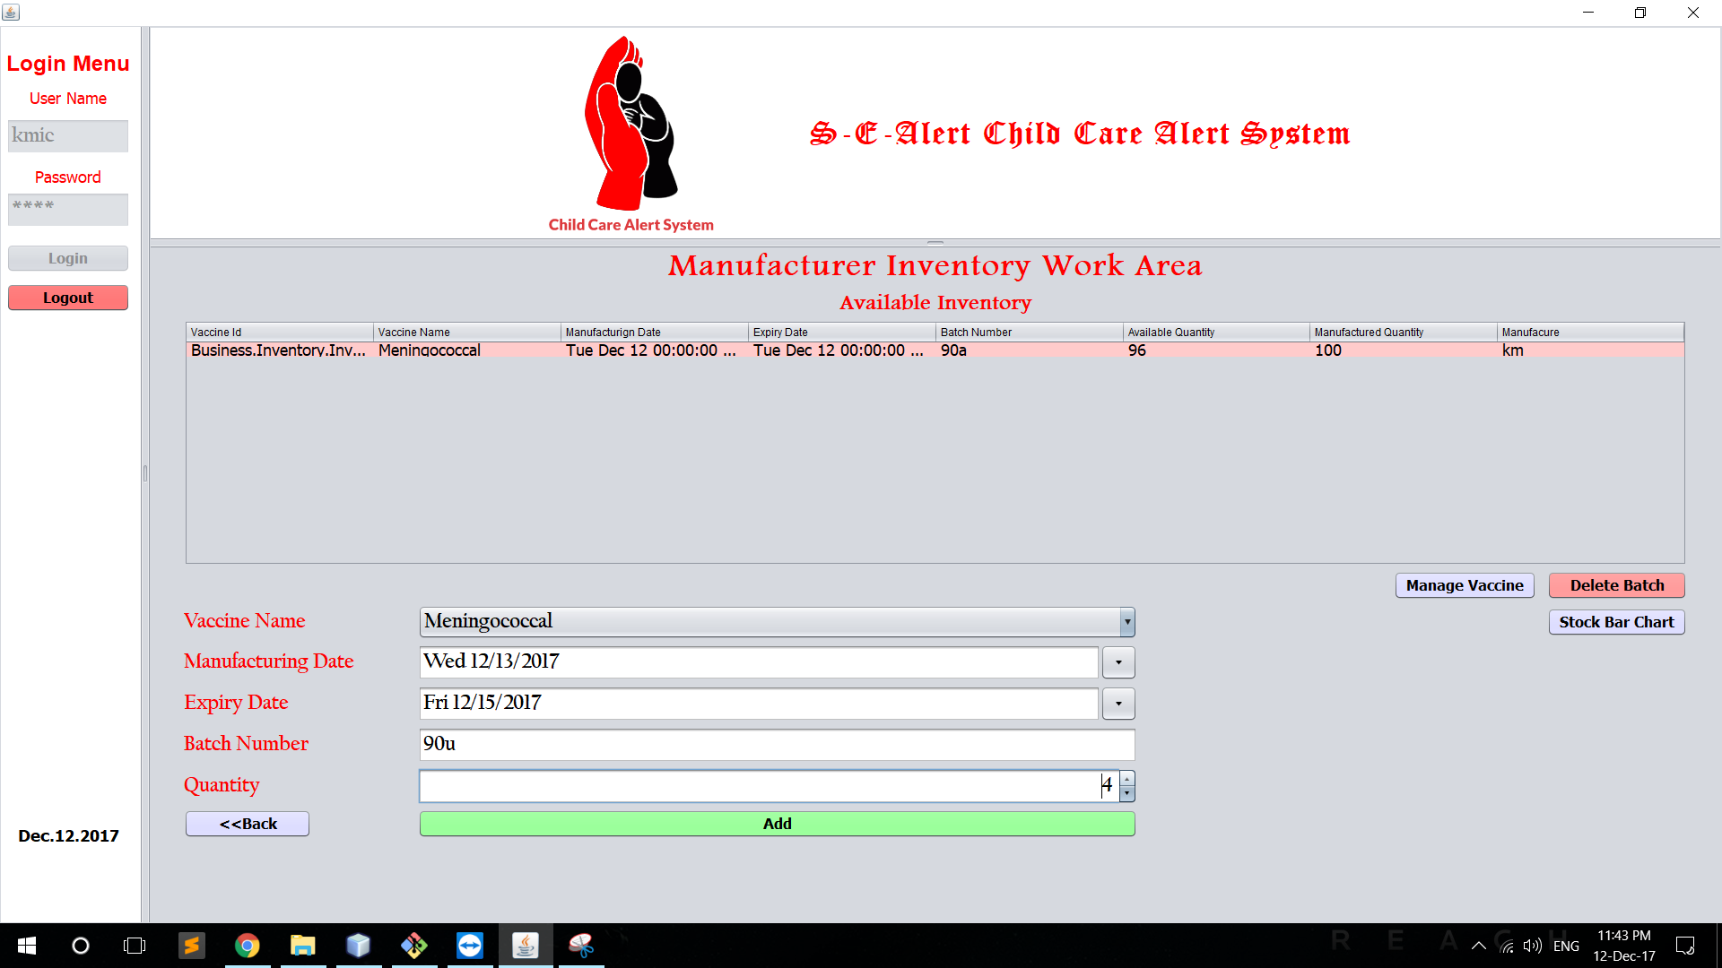

Slide 12
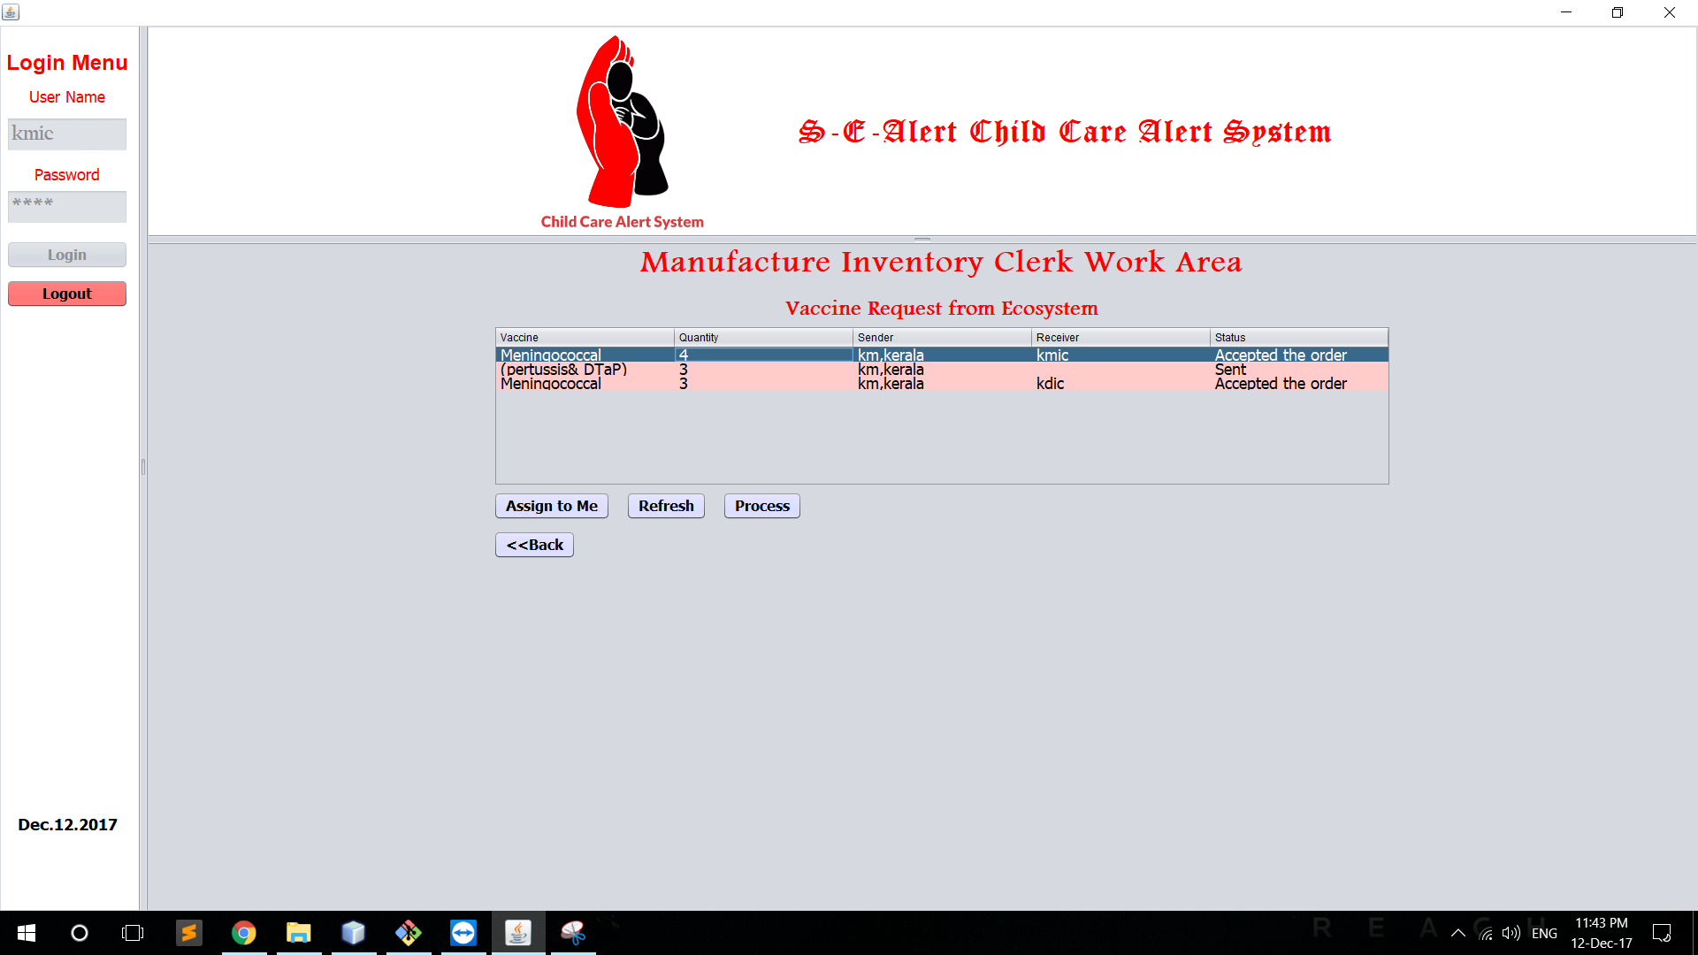

Slide 13
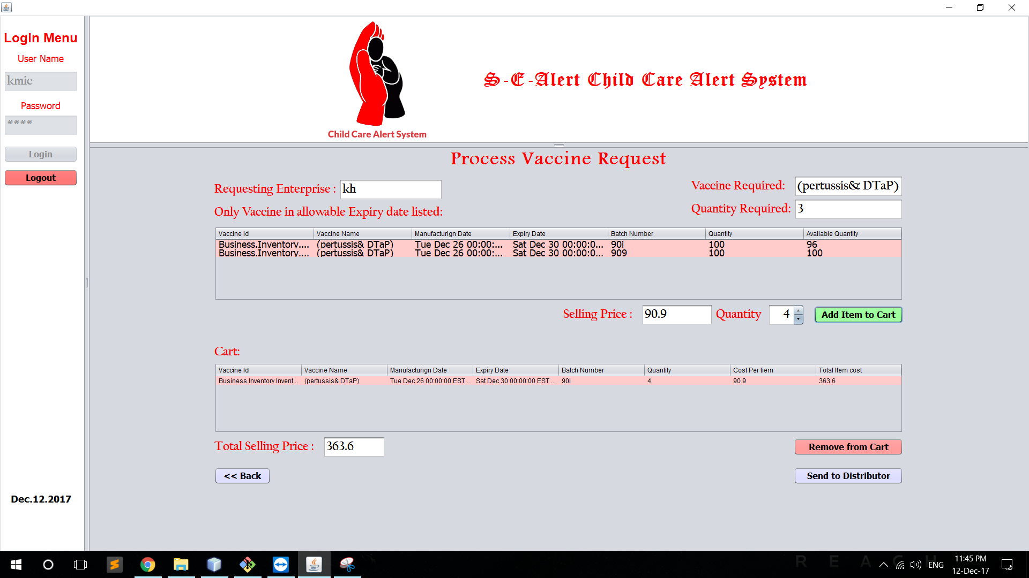

Slide 14
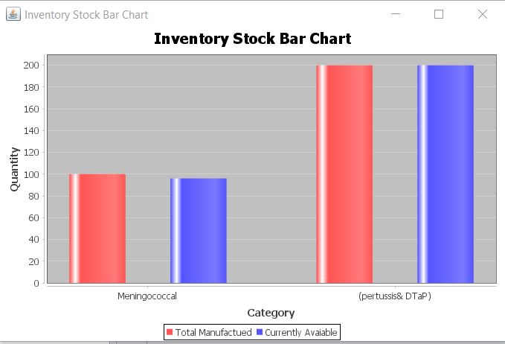

Slide 15
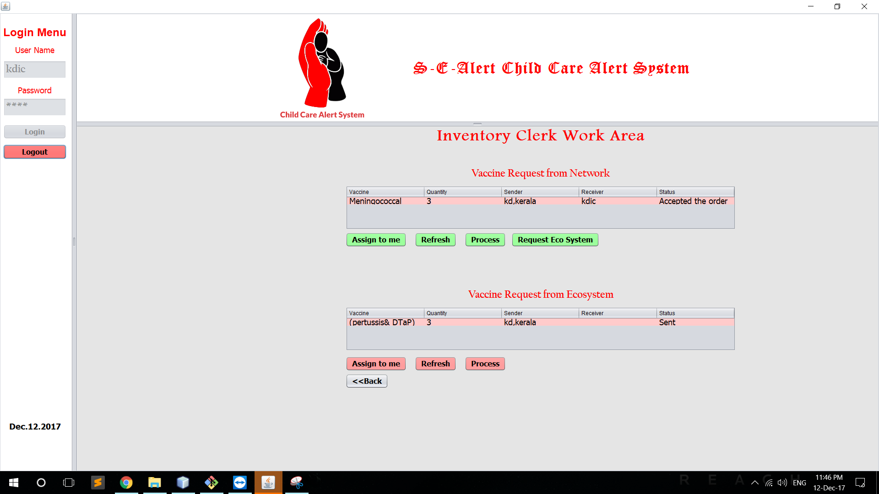

Slide 16
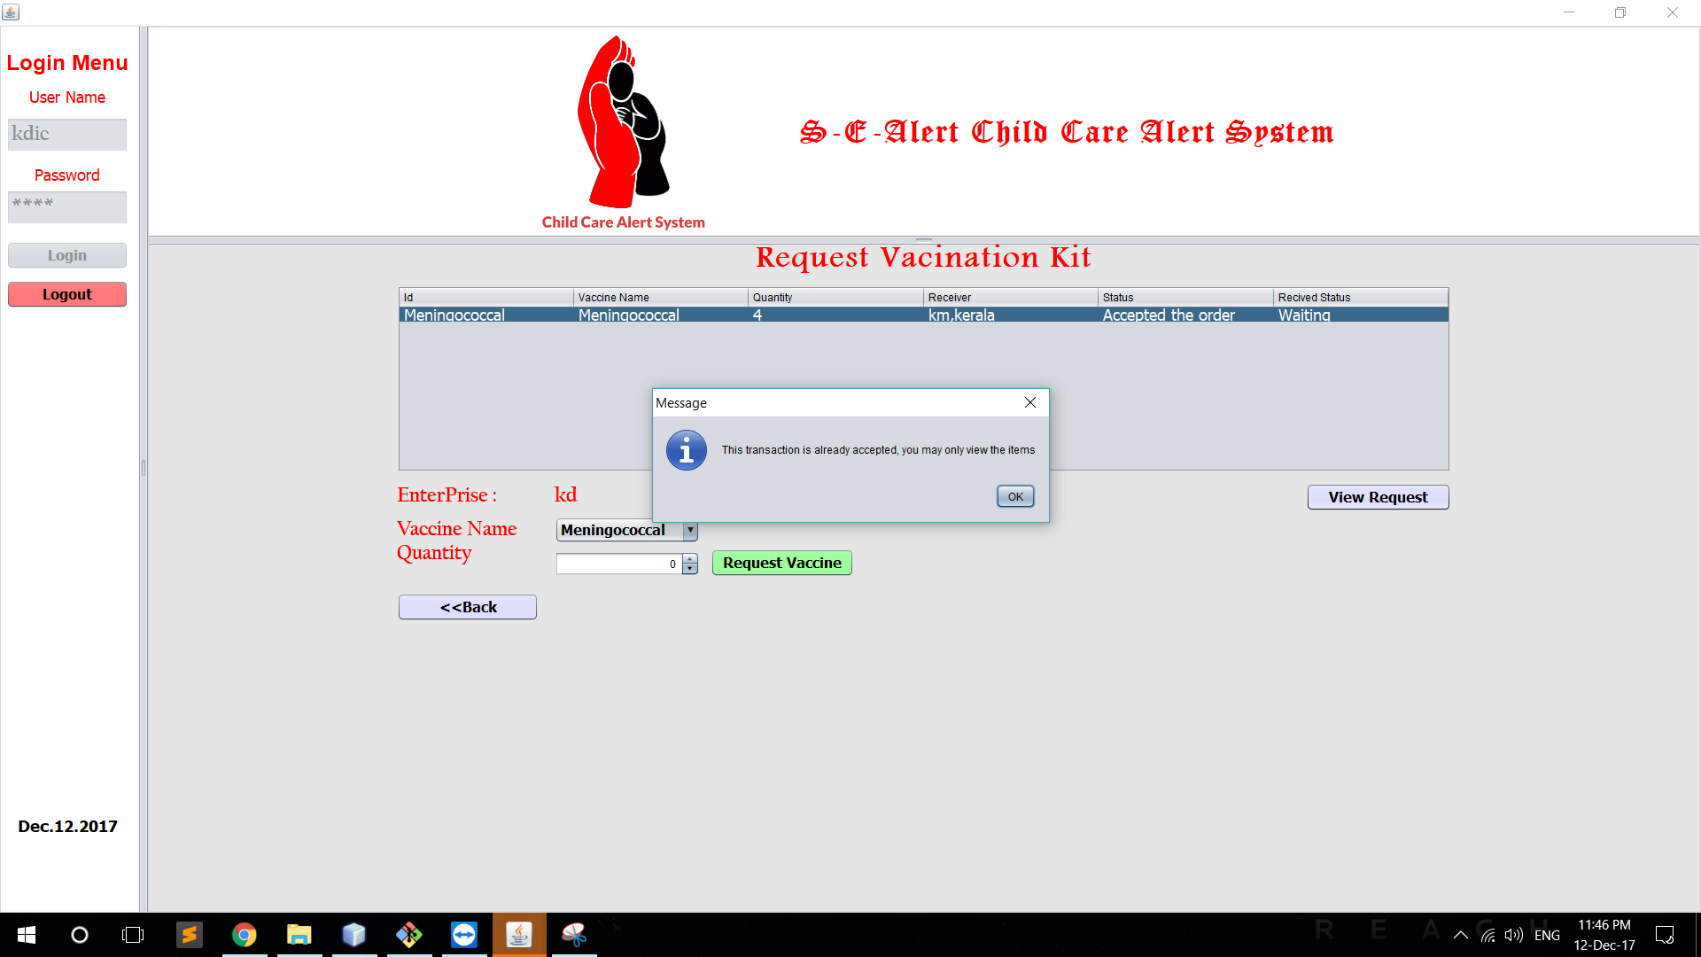

Slide 17
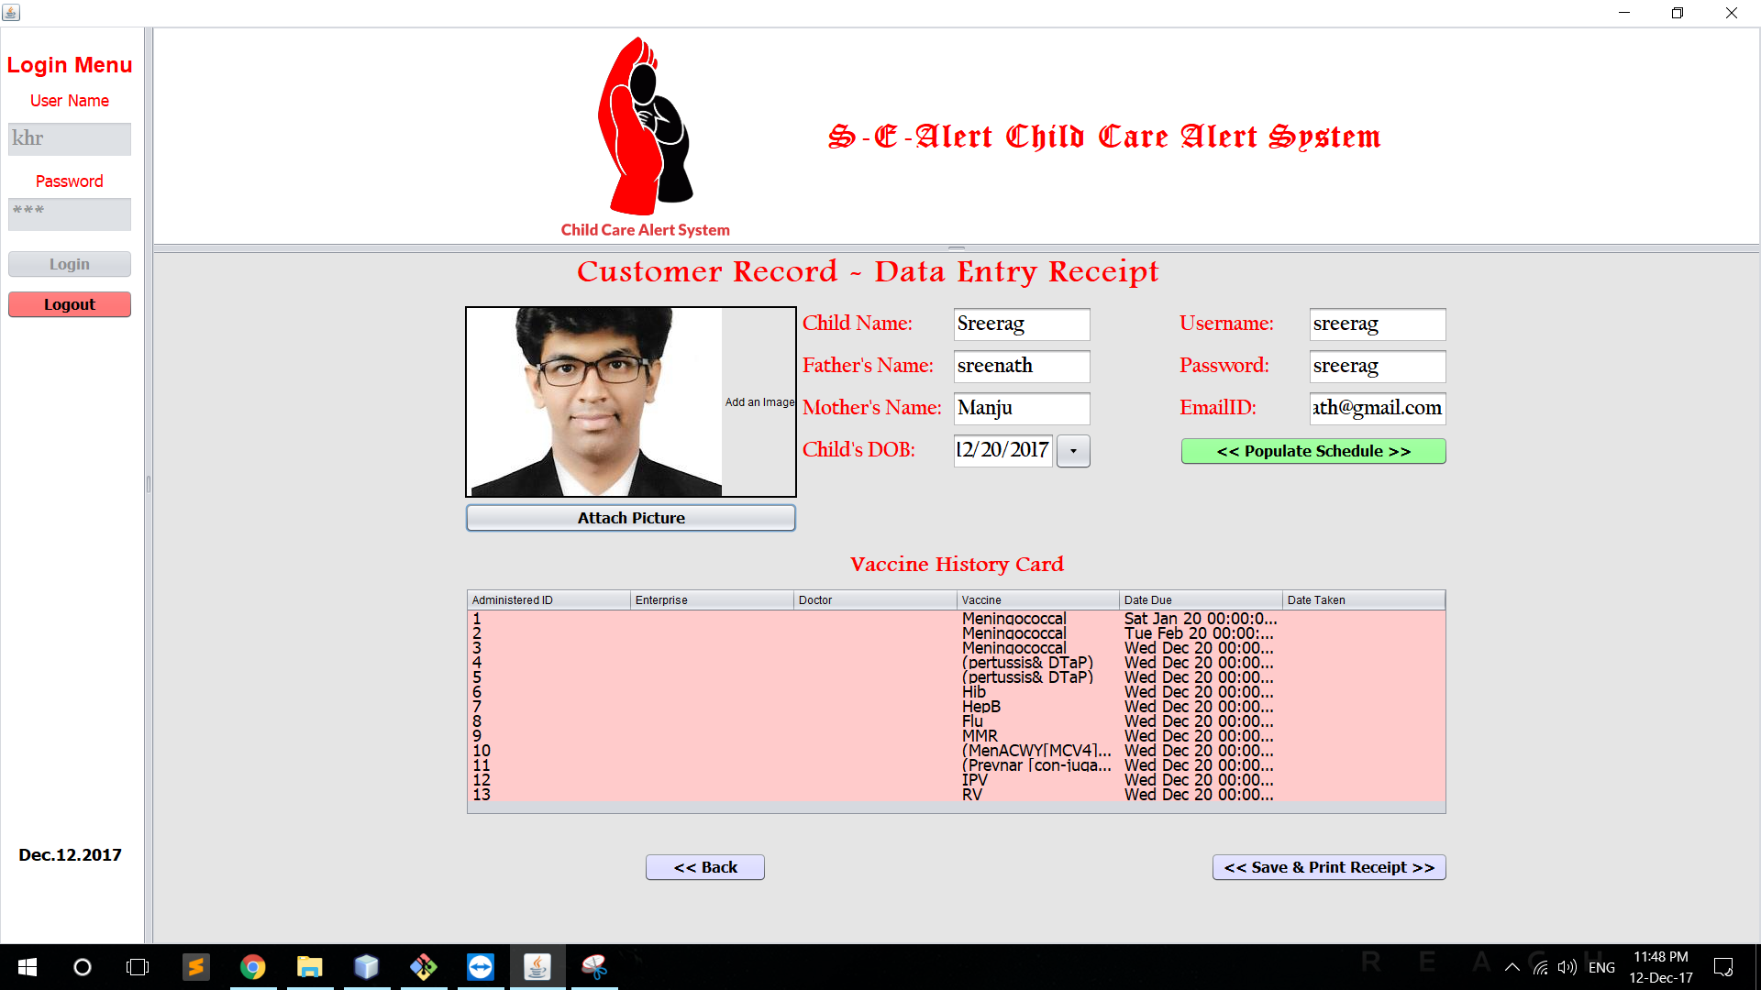

Slide 18
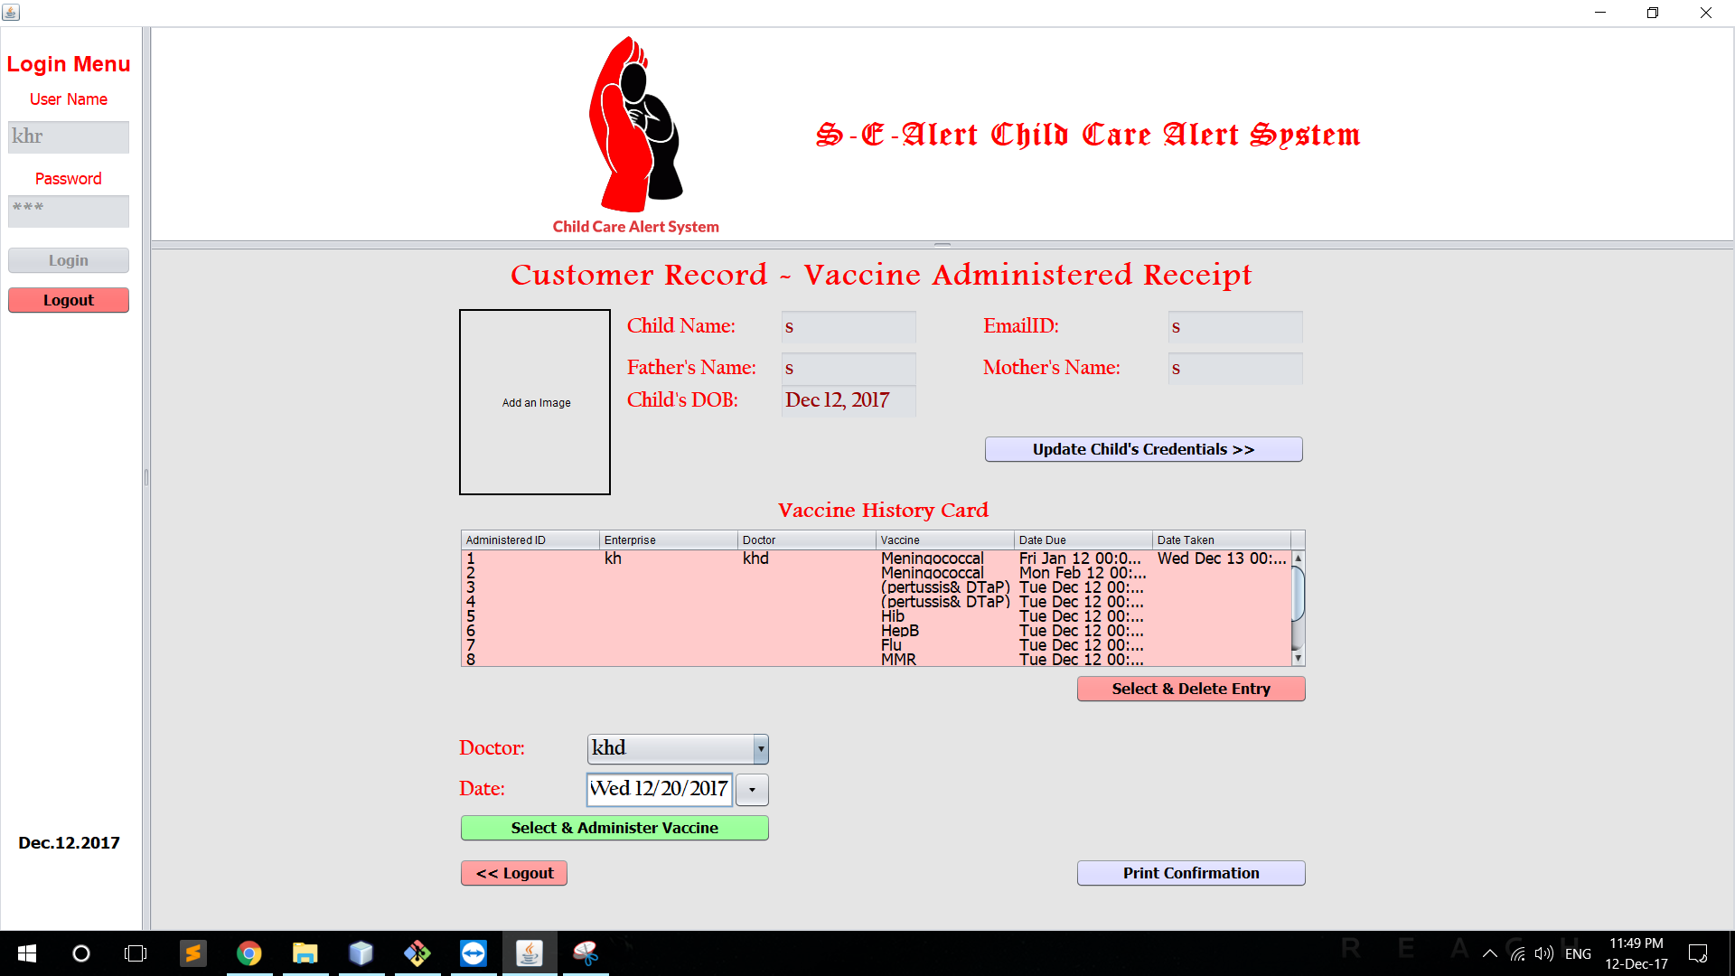

Slide 19
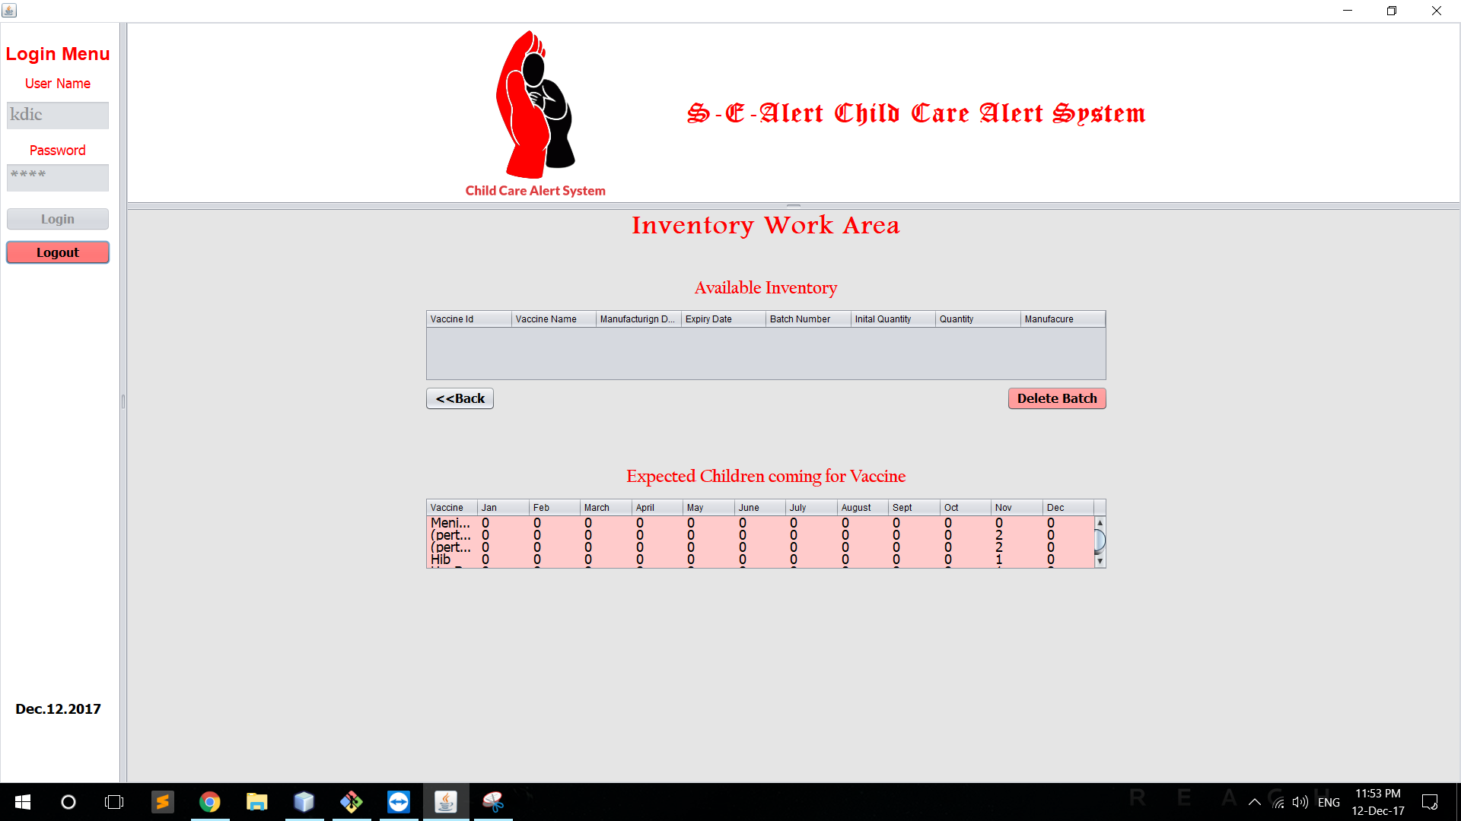

Slide 20
Business Objective
With the system in place:
Hospital with this service will get more customers
Reduce the inventory management for distributors and manufacturers cost by knowing the exact number of vaccine required
It's a social positive project that will help the youth of the nation

